Slide 1
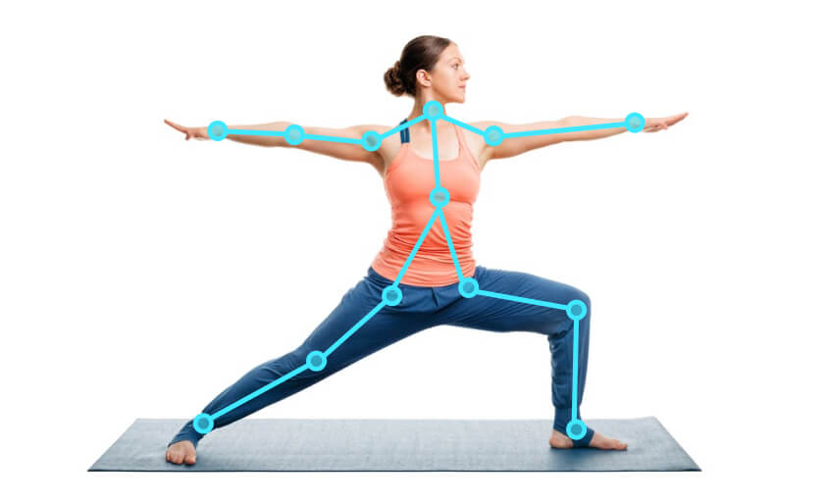
MAJOR PROJECT
BTECH CSE - 2023
YOGA TRAINER USING DEEP LEARNING
AMANPREET KAUR - 19103011
KHUSHI - 19103055
MANAN JAIN - 19103062

Slide 2

Abstract
Pose estimation is one of the real-world problems, where developers try to develop some kind of machine instructors which can monitor the user’s postures and provides live results about the posture status if it is right or wrong.
An attempt to solve this problem has been made with the help of cutting edge technologies available.

Slide 3
Need Of This Project
Yoga - best choices when it comes to staying fit and healthy
not all of us get good results and this might be because we are not following the postures in the right manner
practice the right yoga poses when we don’t prefer an instructor to guide our postures.

Slide 4
Work Plan/Schedule
Data Collection - Where json files are created depending on how many types of data(pose) has to be classified.
Training and classifying - Construct necessary neural network to train the data recorded in the json files.
Frontend of the site - Working upon the user Interface and the appearance of the website/app.
Pipelining - Integration of the trained model with frontend.
Deploying the model - The neural network is trained and now, it receives input from the users and provides required output as per the data(pose) trained.

Slide 5
Data Collection
DATA has been collected from various sources in the web.
From Google Yoga Images
From Kaggle Datasets
https://cocodataset.org/
We have collected following Yoga poses for training the model.
Trikonasana
Tadasana
Vrikshasana
Padahastasana
Ardha-chakrasana
Virabhadrasana
Virabhadrasana 2
adho-mukha svanasana
Phalakasana
Bhujangasana
Shavasana
Padmasana
Ustrasana
Shashankasana
Setu-bandhasana
Pawanmuktasana
Sarvangasana
Dhanurasana
Marjariasana
Vakrasana

Slide 6
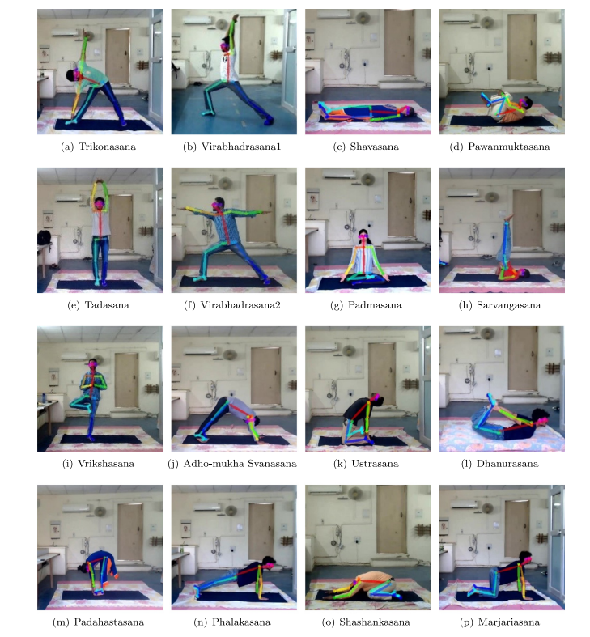

Slide 7
Functional Requirements
Input Feed - We require input image/images to process and pass into our model to make predictions:
Single Image
Real-time Video Feed
ML Model Development - Creating a model which inputs an image and outputs a prediction on which yoga pose is visible in the image along with a confidence score.
Data Collection
Model Design and Training
Hyperparameter Tuning
Output -
Single Image
Real-time Video Feed
Textual feedback

Slide 8
Non-functional requirements
Product requirements:
The device on which our app will run will need a camera of minimum 8MP for real time posture suggestions and for those users who have images then the resolution of the image should be more than 72 pixels per inch in resolution.
Compatability requirements:
Our app will run perfectly on devices which have latest versions of web browsers. They will not face any performance issues unless they are using some very old versions of internet explorer and other browsers.
Software availability :
The software must be accessible and available 24*7.

Slide 9
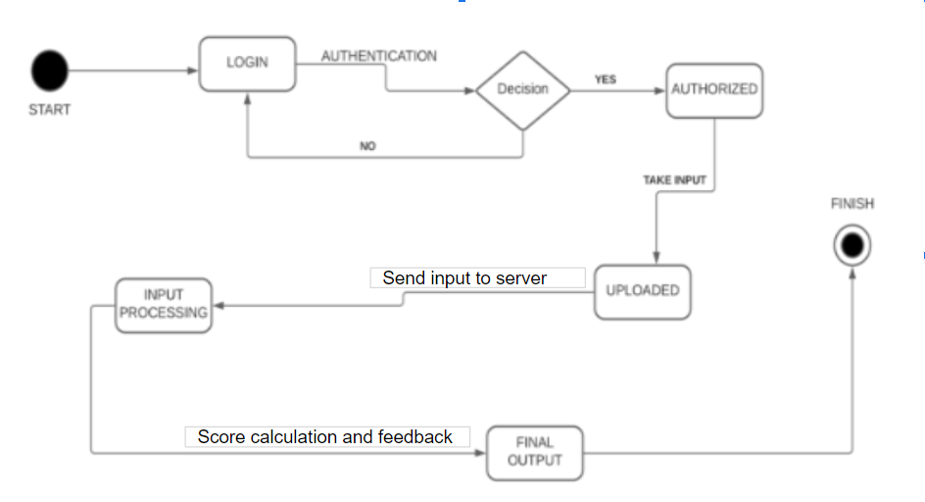
State Diagram

Slide 10
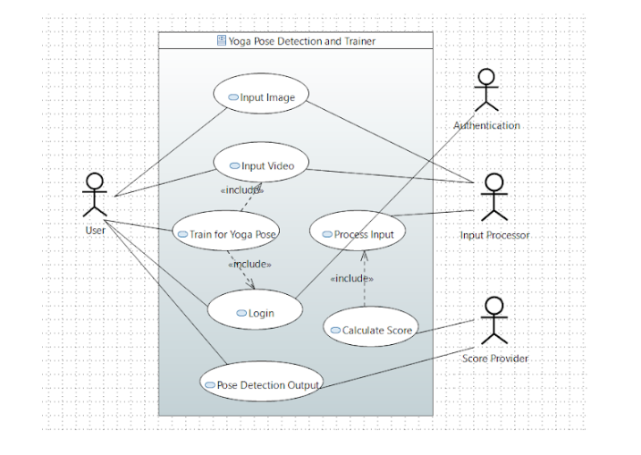
Use Case Diagram

Slide 11
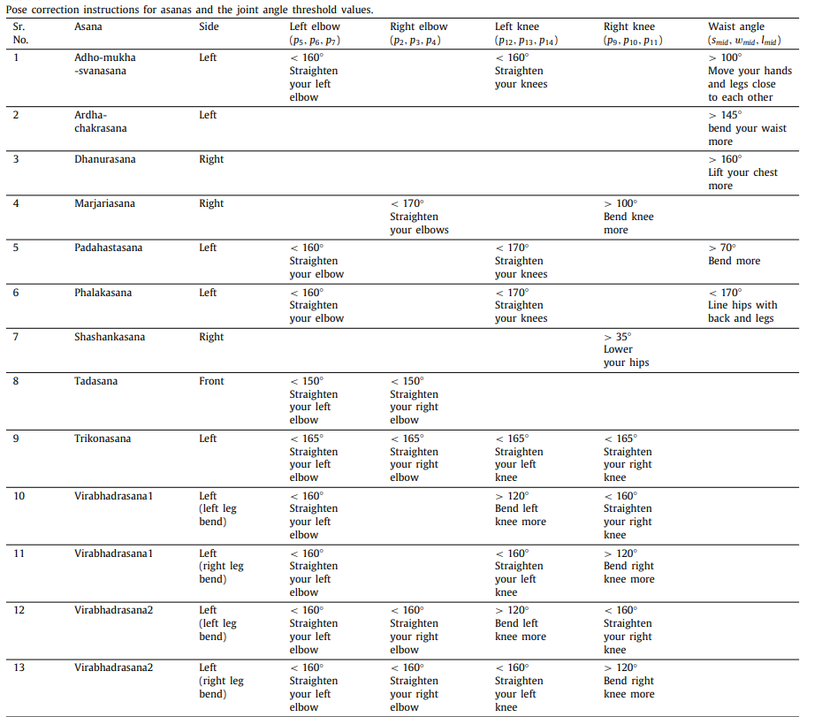
Feedback System

Slide 12
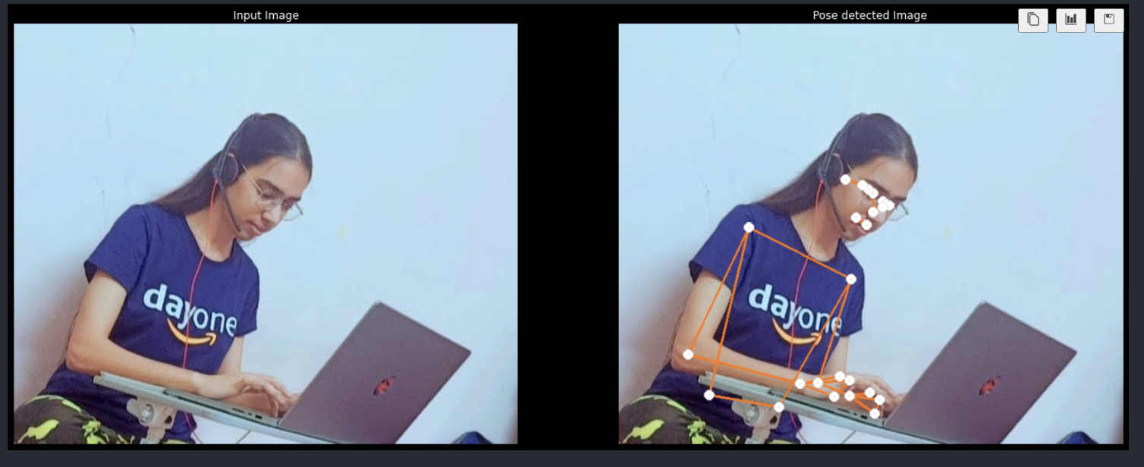

Slide 13
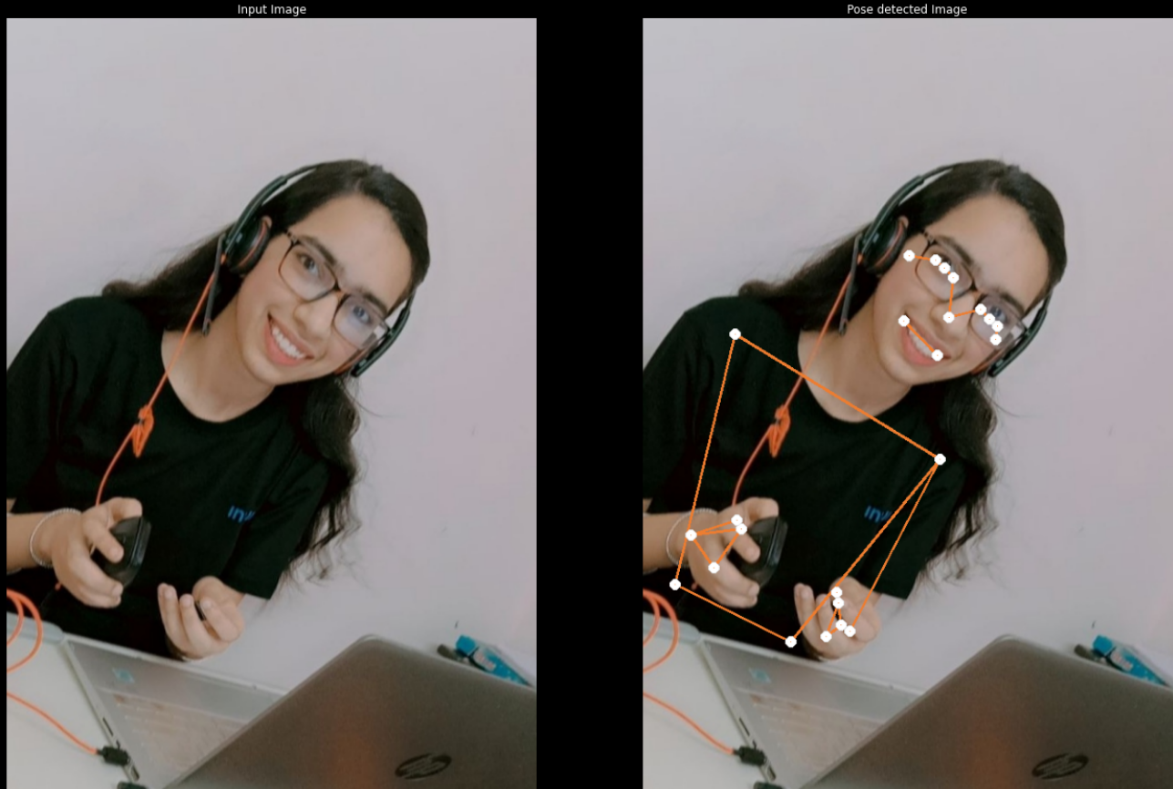

Slide 14
Thank You

